Slide 1
Aviation Map
By: Richard Garmong, Matt Elliott, and Alana Cordak

Slide 2
Aviation Map
Aviation Weather Center: downloaded data
PIREP (Pilot Report): actual weather conditions encountered by aircraft in flight
METAR (Meteorological Terminal Aviation Routine Weather Report): reported weather info (i.e. temp, dewpoint, wind speed/direction, visibility, etc.)
AIRMET (Airmen’s Meteorological Information): description of weather along an air route, may affect aircraft safety; covers less severe wx than SIGMET
SIGMET (Signif. Meteorological Information): wx advisories that contain info concerning safety of all aircraft, even the big boys. (Outlook vs active; convective vs non-convective)
Data + interact with map background (Leaflet: open source JavaScript library to help build web mapping applications) // map base and plot data on
Notes:
About 1 minute
Break into 2

Slide 3
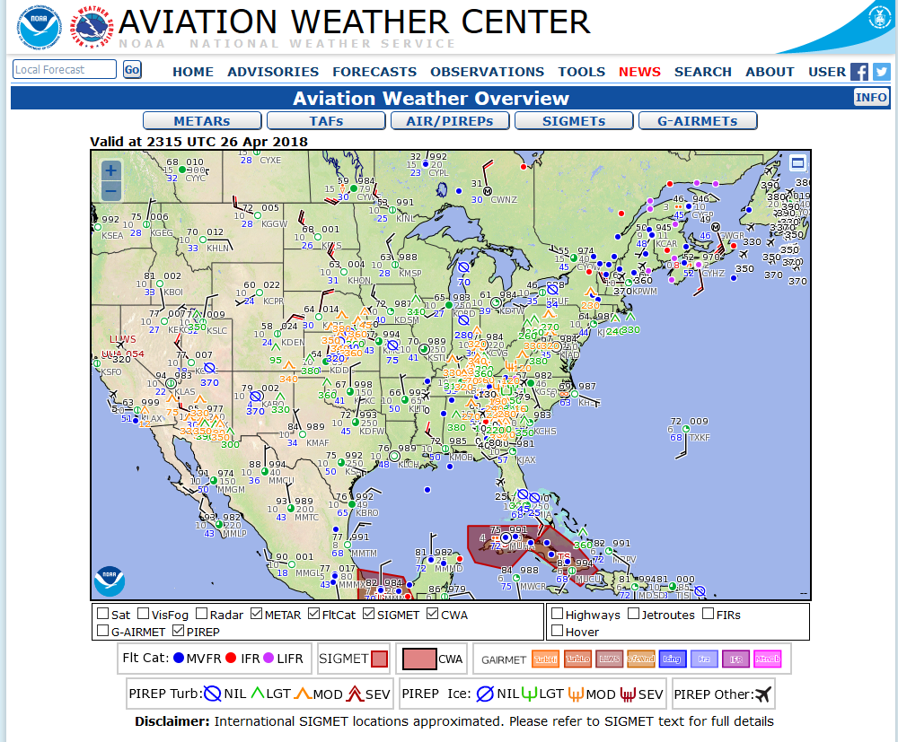
Why do we care?

Slide 4
The Code Behind the Map
How did/code it
Advanced code uses / applications
Flask (Python package): data server
Leaflet: map background
JavaScript
HTML: Hypertext Markup Language
CSS: Cascading Style Sheets
AJAX:Asynchronous JavaScript And XML
Notes:
About 1.5 minutes

Slide 5
Results (Visuals)
http://127.0.0.1:5000/
Notes:
About 2.5 minutes

Slide 6

Questions?
Notes:
About 2 minutes

